Slide 1
Laptop Ecommerce Website Development Project
Managing A Successful Computing Project
Lecturer:
Cao Thị Nhạn
Trình Trọng Tín

Slide 2
Scrum Team
Role | Name
Scrum Master | Ngô Lê Hạnh Dung
Product Owner | Lê Gia Huy
Development Team | Nguyễn Trần Gia Huy
 | Lữ Tâm Thái

Slide 3
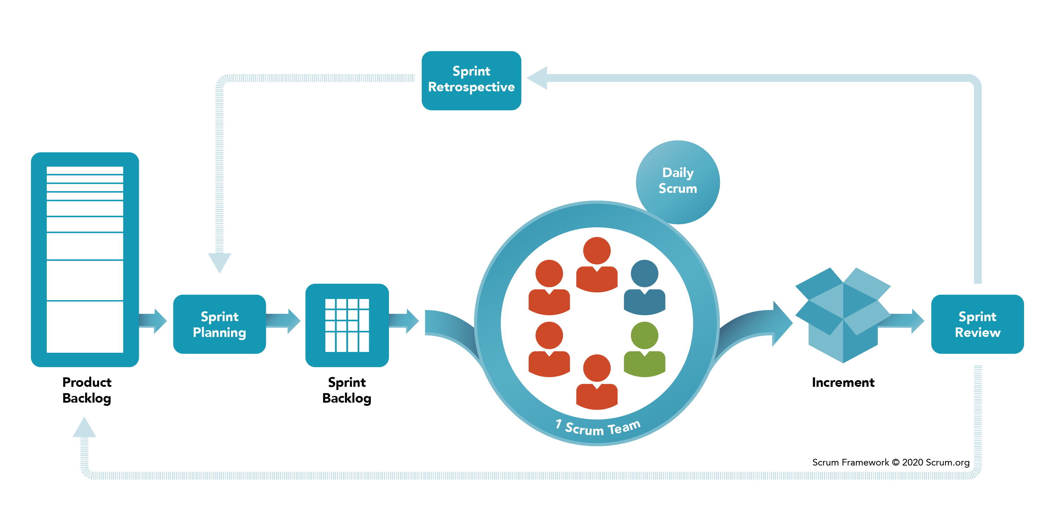
Scrum Framework

Slide 4
01
02
Project Basic Tasks
03
04
Setup Ecommerce Website Using
WooCommerce Plugin Wordpress
Create Products
Set Product Categories
Install Wordpress Plugin:
Payment + Shipping Methods

Slide 5
Project Planning
Project Duration: 7 days
Sprint Planning: 4 sprints = 4 basic tasks
Daily Scrum Meeting: 7h30 (5 mins)
Sprint Meeting: 19h00 (60 mins)
Sprint Meeting = Current Sprint Planning + Previous Sprint Review & Retrospective

Slide 6
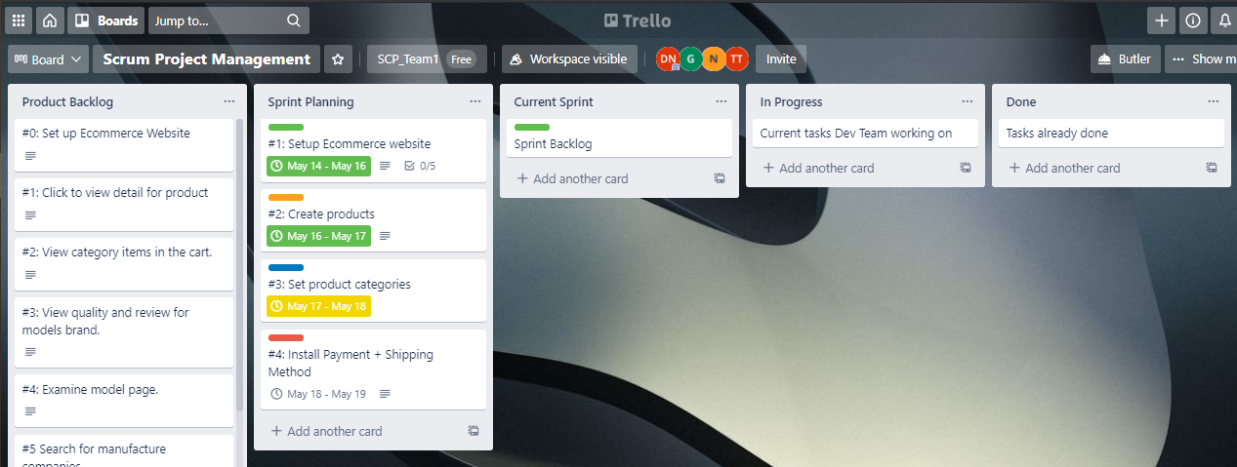
Trello Board

Slide 7
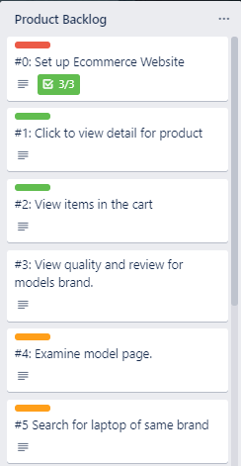
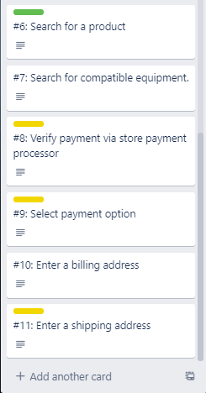
Product Backlog

Slide 8
Sprint Overview
Sprint 1
Sprint 2
Setup Ecommerce website
Create products
#1
#2
#3
#4
Sprint 3
Sprint 4
Set product categories
Install Payment + Shipping Method

Slide 9
Sprint 1
Setup Ecommerce Website

Slide 10
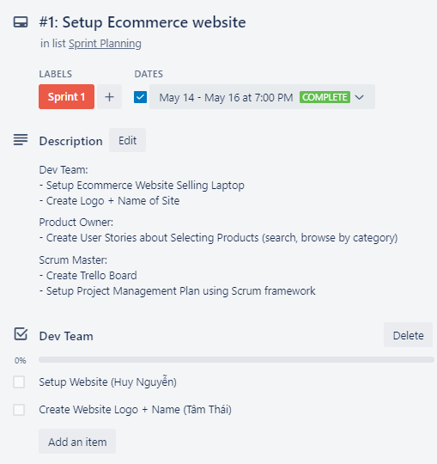
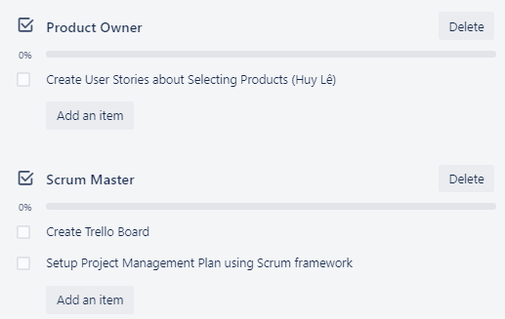
Sprint Planning

Slide 11
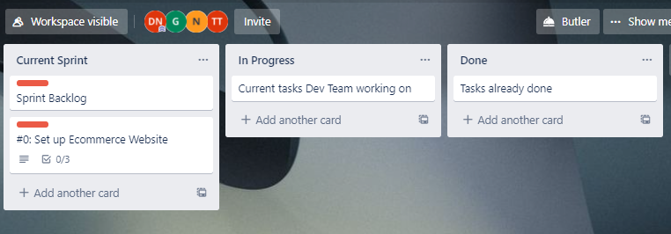
Sprint Management

Slide 12
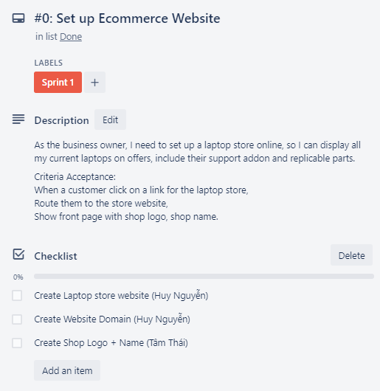
Sprint Backlog

Slide 13
Sprint 2
Create Products

Slide 14
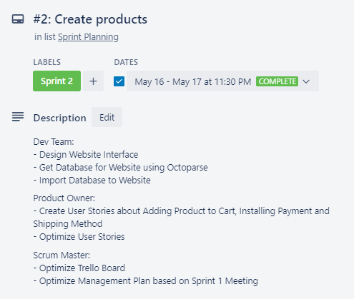
Sprint Planning

Slide 15
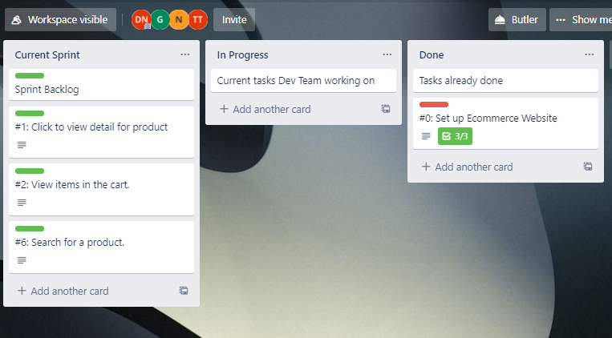
Sprint Management

Slide 16
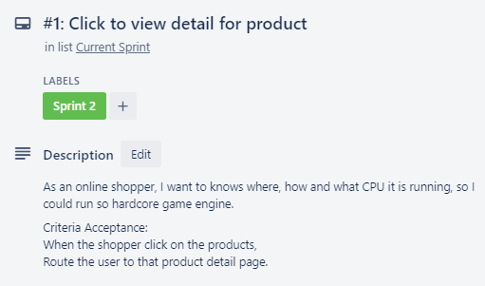
Sprint Backlog

Slide 17
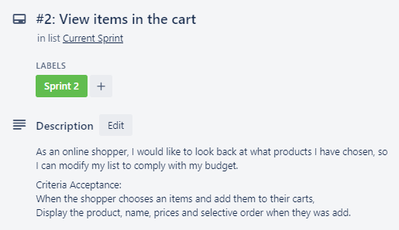
Sprint Backlog

Slide 18
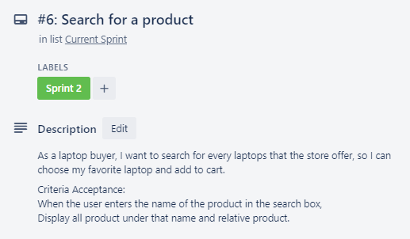
Sprint Backlog

Slide 19
Sprint 3
Set Product Categories

Slide 20
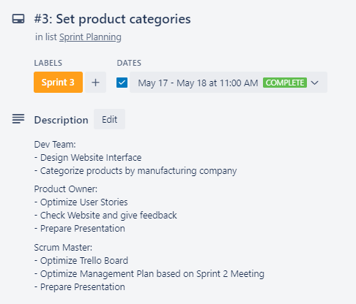
Sprint Planning

Slide 21
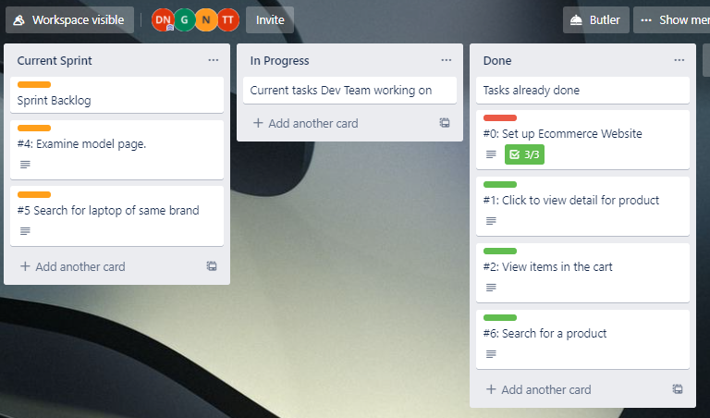
Sprint Management

Slide 22
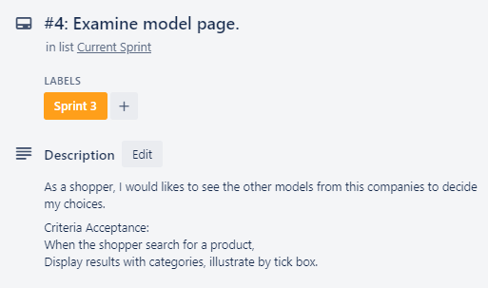
Sprint Backlog

Slide 23
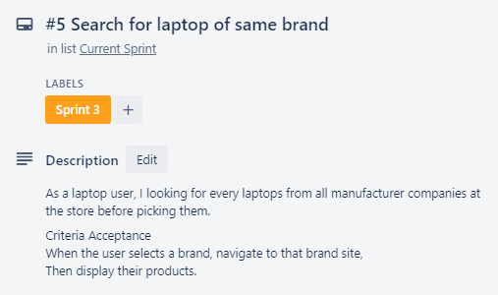
Sprint Backlog

Slide 24
Sprint 4
Install Wordpress Plugin: Payment + Shipping Methods

Slide 25
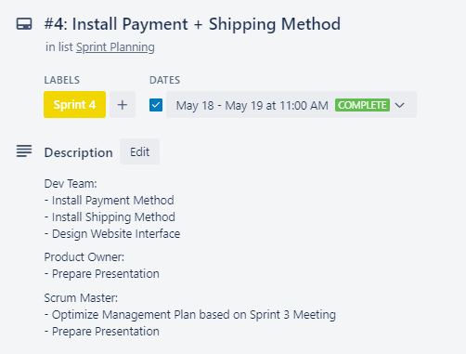
Sprint Planning

Slide 26
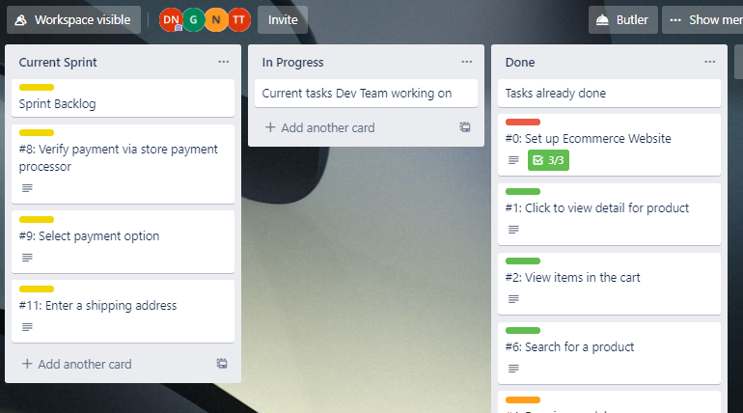
Sprint Management

Slide 27
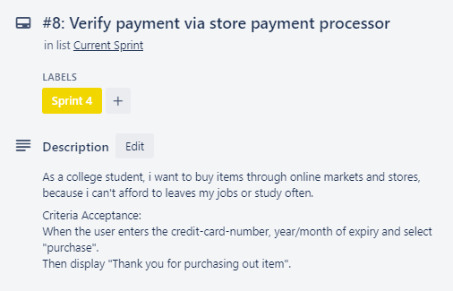
Sprint Backlog

Slide 28
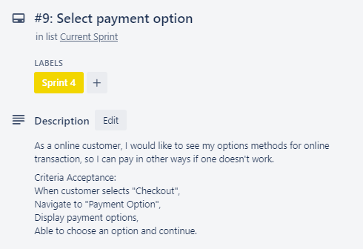
Sprint Backlog

Slide 29
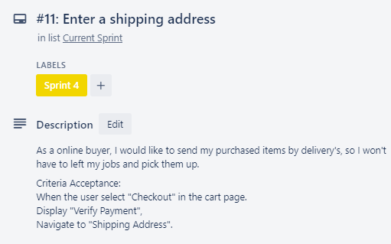
Sprint Backlog

Slide 30
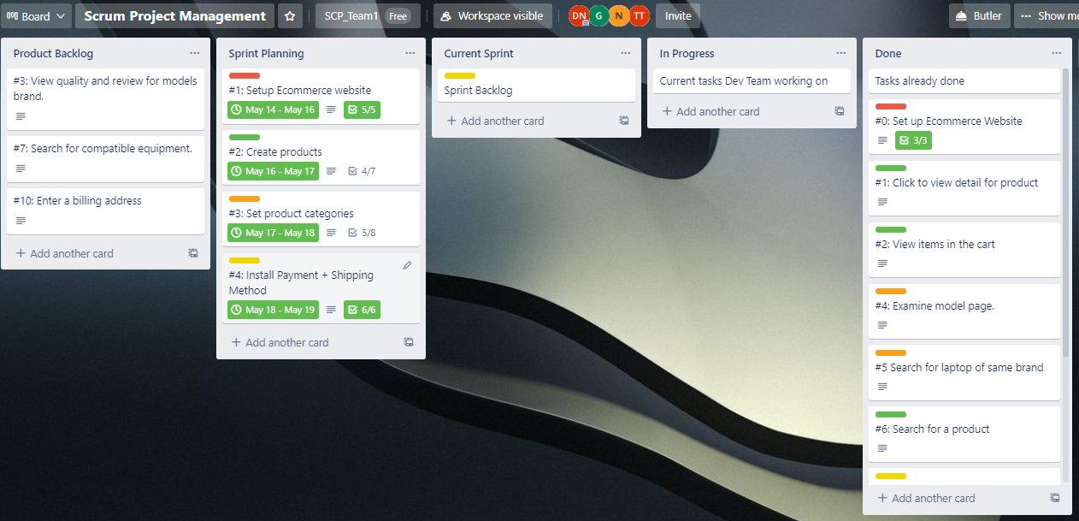
Final Trello Board

Slide 31
Project Summary
Setup website using WAMP environment, Wordpress, WooCommerce, Flatsome theme.
Design a user-friendly website interface.
Get product data (name, photo, price, description) using Octoparse from:
xgear.vn
amazon.com
Categorize products based on manufacturing companies.
Add provinces and districts for Vietnam when Vietnamese users give a shipping address.

Slide 32
Thanks!
Do you have any questions?

